Slide 1

Distributed Generation
The Regulatory Future of Clean, Reliable Energy
Dennis Arfmann & Tiffany Joye
Hogan Lovells, LLP
February 1, 2012

Slide 2
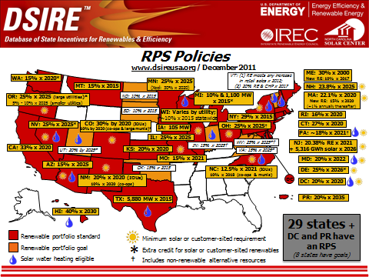
RPS Policies as of December 2011

Slide 3
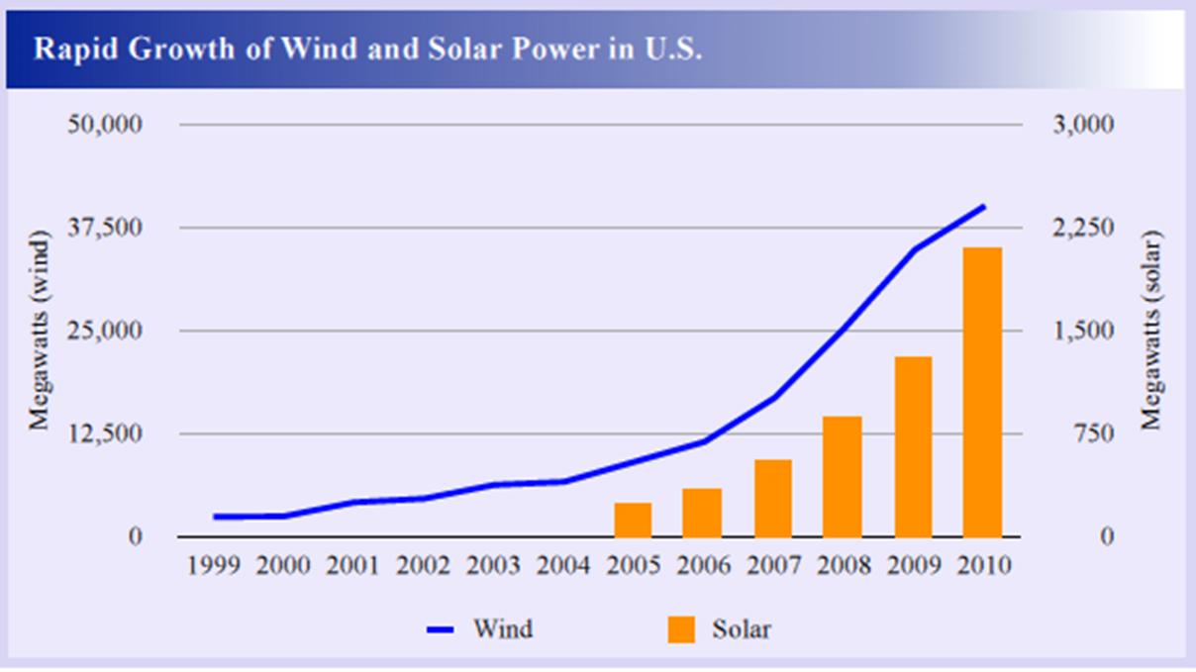
RPS Policies are Driving Renewable Generation

Slide 4
What is Distributed Generation (“DG”)?
“Electric power source connected directly to the distribution network or on the customer side of the meter.” Swedish Royal Institute of Technology, Dep’t of Electric Power Engineering definition
DG electric-generating technologies include renewable generation:
Combined heat and power
Small wind installations
Small solar plants
Engines, Turbines, Fuel cells
Storage Generation (hydro and battery storage)

Slide 5
DG in the U.S.
Regulatory Precursor to DG facilities: QF’s connect to the utility high voltage T-line
DG connect at the lower voltage side, at or inside the substation or inside the meter
Regulation is heavily state and city dependent
FERC regulates wholesale markets, interstate transmission, connection to the high-voltage T-line
States regulate retail markets, intrastate transmission, connection to the lower-voltage distribution lines

Slide 6
Recent DG State Statutes: California
SB 2: 33% of total electricity must be renewable by Dec. 31, 2020
California intends to generate over 12,000 MW of renewable DG by 2020
CA IOUs and munis are developing new energy storage and EVs for storage
AB 1150, SB 412: Amended the Self-Generation Incentive Program (a CA DG incentive program), extending the time frame and allowing for the use of more renewable technologies

Slide 7
Recent DG State Statutes: Colorado
2010 HB 1001 (codified at Colo. Rev. Stats. § 40-2-124)
“‘Retail distributed generation’ . . . shall be sized to supply no more than one hundred twenty percent of the average annual consumption of electricity by the customer at that site.” Colo. Rev. Stats. § 40-2-124(1)(a)(V).
“‘Wholesale distributed generation’ means a renewable energy resource in Colorado with a nameplate rating of thirty megawatts or less and that does not qualify as retail distributed generation.” Id. at § 40-2-124(1)(a)(VI).
Renewable standard: “Thirty percent of its retail electricity sales in Colorado for the years 2020 and thereafter, with distributed generation equaling at least three percent of its retail electricity sales.” Id. at § 40-2-124(1)(c)(I)(E).

Slide 8
Fort ZED Experience (Spirae)
5 MW Pilot completed in 2011-integrated and coordinated a system of mixed distributed resources – including renewable generation, rotary- and inverter-based generation, PHEV and V2G vehicles, and demand response methods.
NEXT: 50 Megawatt Community
The Downtown area of Fort Collins is ready to become its own net zero energy district. SMART GRIDCreating a 5 Megawatt jump start demonstration using Smart Grid technology and reducing peak load demand by 20-30%

Slide 9
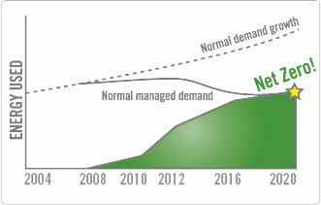
Fort ZED

Slide 10
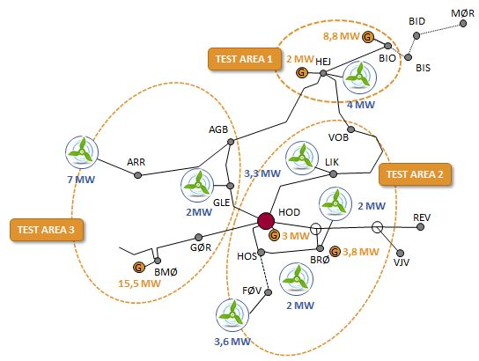
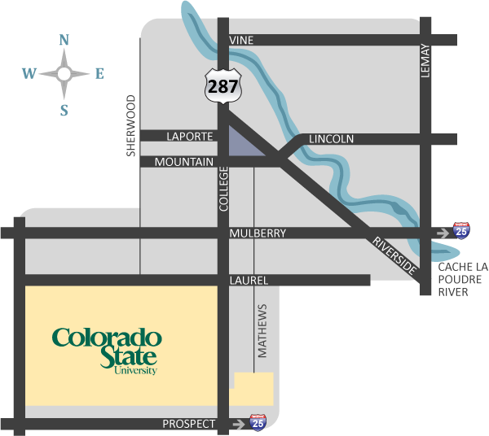
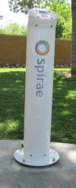
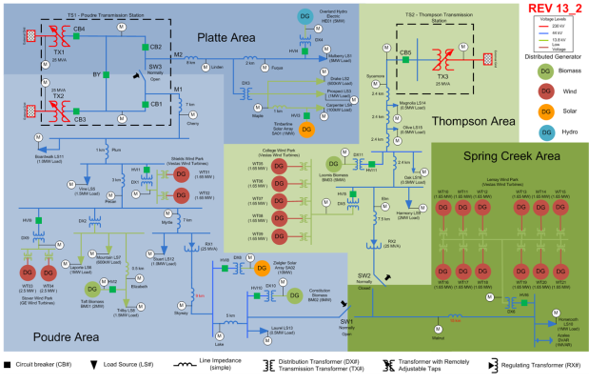

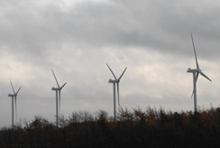
Spirae Project Examples
Cell Controller Project - Denmark
FortZED/RDSI - Colorado
Smart Grid Demo - Northwest
Wind Integration
Kalundborg Smart City
Wind Balancing using DR

Slide 11
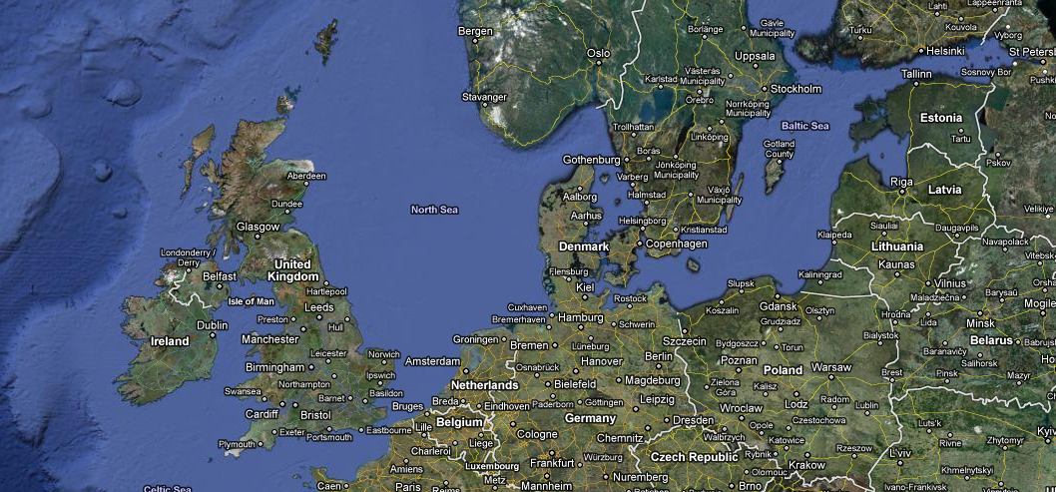
Danish Cell Controller Project
Provide overview of Danish Cell Controller Project
Summarize technology and major accomplishments
Relevance to military microgrid applications

Slide 12
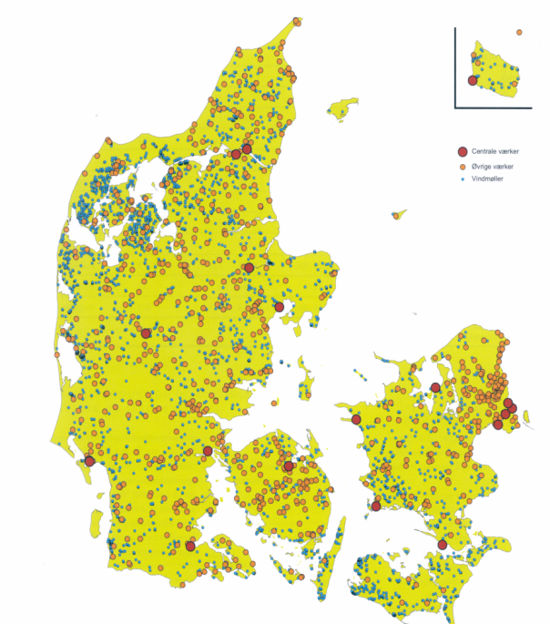
Danish Power Generation from 1980s to Present
Primary Generation
Local Generation
Central power plant
DCHP unit
Wind turbine
Growing the “DG/Wind Carpet” requires new approach to grid management
Source: Energinet.dk

Slide 13
Denmark’s Energy Supply Goals
EU members have 2020 goals for renewable energy use:
Denmark’s goal is for 42% renewable energy use
Amounts to a 33% reduction in fossil fuel from 2009 levels
To achieve this number, goal is for 62% of electricity used to come from renewable sources
In addition, Denmark has a 2050 goal of complete fossil-fuel independence
(Source: Danish Ministry of Climate and Energy)

Slide 14
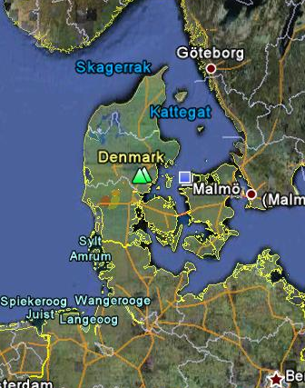
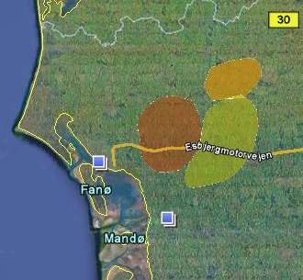
Energinet.DK Cell Controller Pilot Project
Prepare for higher penetration renewable DER
Ensure grid reliability through intentional islanding
Enable additional ancillary value streams through ancillary services
Provide replicable model
Area 1
Area 2
+
Area 3
Holsted Cell
≈ 1,000 km²
≈ 28,000 customer
meters

Slide 15
Energinet.dk Cell Controller Project Distributed Generation and Cell Structure
4 central CHP units (1488 MW)
6 central CHP units (2014 MW)
Horns Rev offshore wind farm (160 MW)
Cell
17 dispersed CHP units (569 MW)
34 wind turbines (41 MW)
475 dispersed CHP units (991 MW)
2180 wind turbines (1597 MW)
260 dispersed CHP units (83 MW)
1860 wind turbines (576 MW)

Slide 16

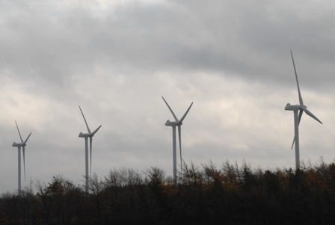
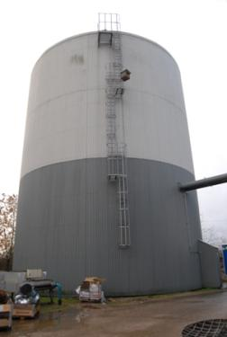
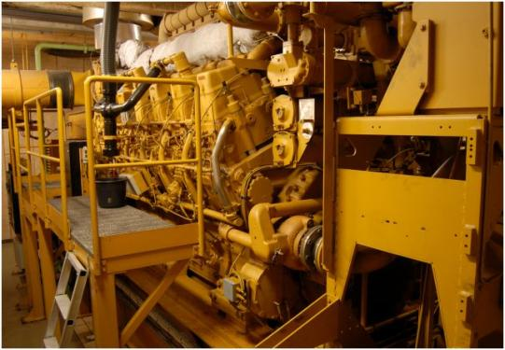
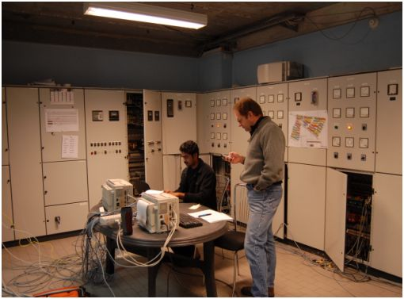
Energinet.dk Cell Controller Project Test Area
MØR
Pilot Cell: Holsted 60kV Grid Area
13 Substations, ~1000km²
Installed CHP: 37MW
Installed Wind: 39MW
Max Load: 61MW
150/60 kV Trafo: 100MVA
BID
8,8 MW
G
TEST AREA 1
2 MW
HEJ
BIO
BIS
G
4 MW
AGB
VOB
ARR
LIK
7 MW
3,3 MW
TEST AREA 2
2MW
GLE
HOD
2 MW
REV
TEST AREA 3
3 MW
GØR
G
HOS
G
3,8 MW
BRØ
VJV
G
BMØ
15,5 MW
FØV
2 MW
3,6 MW

Slide 17
Energinet.dk Cell Controller Project Test Area
MØR
Pilot Cell:
Holsted 60kV Grid Area
Installed CHP: 37MW
Installed Wind: 39MW
Max Load: 61MW
150/60 kV Trafo: 100MVA
BID
8,8 MW
G
TEST AREA 1
2 MW
HEJ
BIO
BIS
G
4 MW
AGB
VOB
ARR
LIK
7 MW
3,3 MW
TEST AREA 2
2MW
GLE
HOD
2 MW
REV
TEST AREA 3
3 MW
GØR
G
HOS
G
3,8 MW
BRØ
VJV
G
BMØ
15,5 MW
FØV
2 MW
3,6 MW

Slide 18
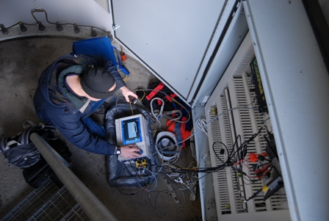
Wind Turbines and CHPs

Slide 19
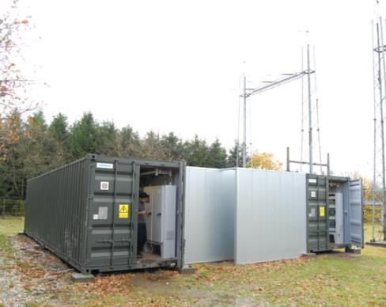
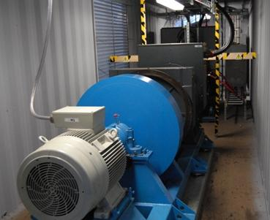
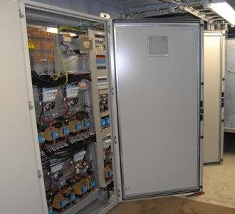
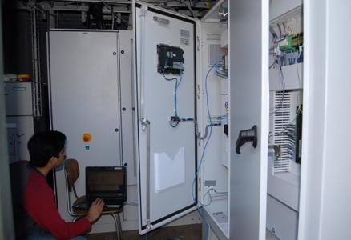
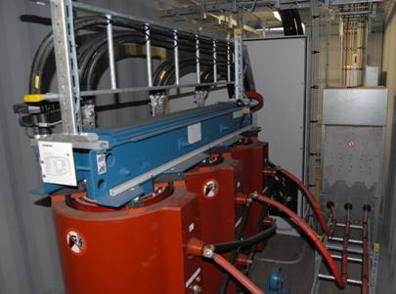
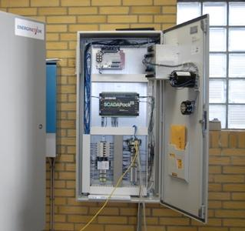
Synchronizer, Synch Condenser, and Secondary Load Controller

Slide 20
Cell Controller Capabilities and Benefits
Capabilities
Power Import/Export using DER at remote interties
Firm wind production using DER
Aggregated market participation for DER
Feeder Volt/VAR control using DER
Fast islanding and resynchronization
Benefits
Maximize value of DER by exposing multiple value streams
DNO can enable new services to multiple parties
TSO can leverage assets on the distribution network for network reliability and optimization
Market Operators can aggregate and dispatch DER to market
Same portfolio of DER can be used for multiple applications

Slide 21
FortZED – Ft. Collins Zero Energy District
Long Term Goal: “Zero Energy District”
A (net) Zero Energy District is one that creates as much thermal and electrical energy locally as it uses annually.
WA
MT
ND
ME
OR
ID
MN
VT
NH
WY
SD
WI
NY
MA
MI
CT
RI
NV
NE
IA
OH
PA
NJ
UT
IL
DE
CA
CO
IN
WV
MD
KS
MO
KY
VA
DC
AZ
NM
OK
TN
NC
AR
SC
TX
LA
MS
AL
GA
FortZED Jumpstart Zone:
DOE-RDSI funded
One of nine projects awarded
$11.1m project ($6.5m + match)
2 of 8 feeders serving FortZED
Peak Demand: ~7-8 MW/feeder
Allows use of wide variety of distributed and renewable energy resources for grid management
FL

Slide 22
RDSI Feeder Loads - July 2010

Slide 23
FortZED/RDSI Project Sites and Resources
Spirae’s platform enables DER to be automatically dispatched for real time grid management

Slide 24
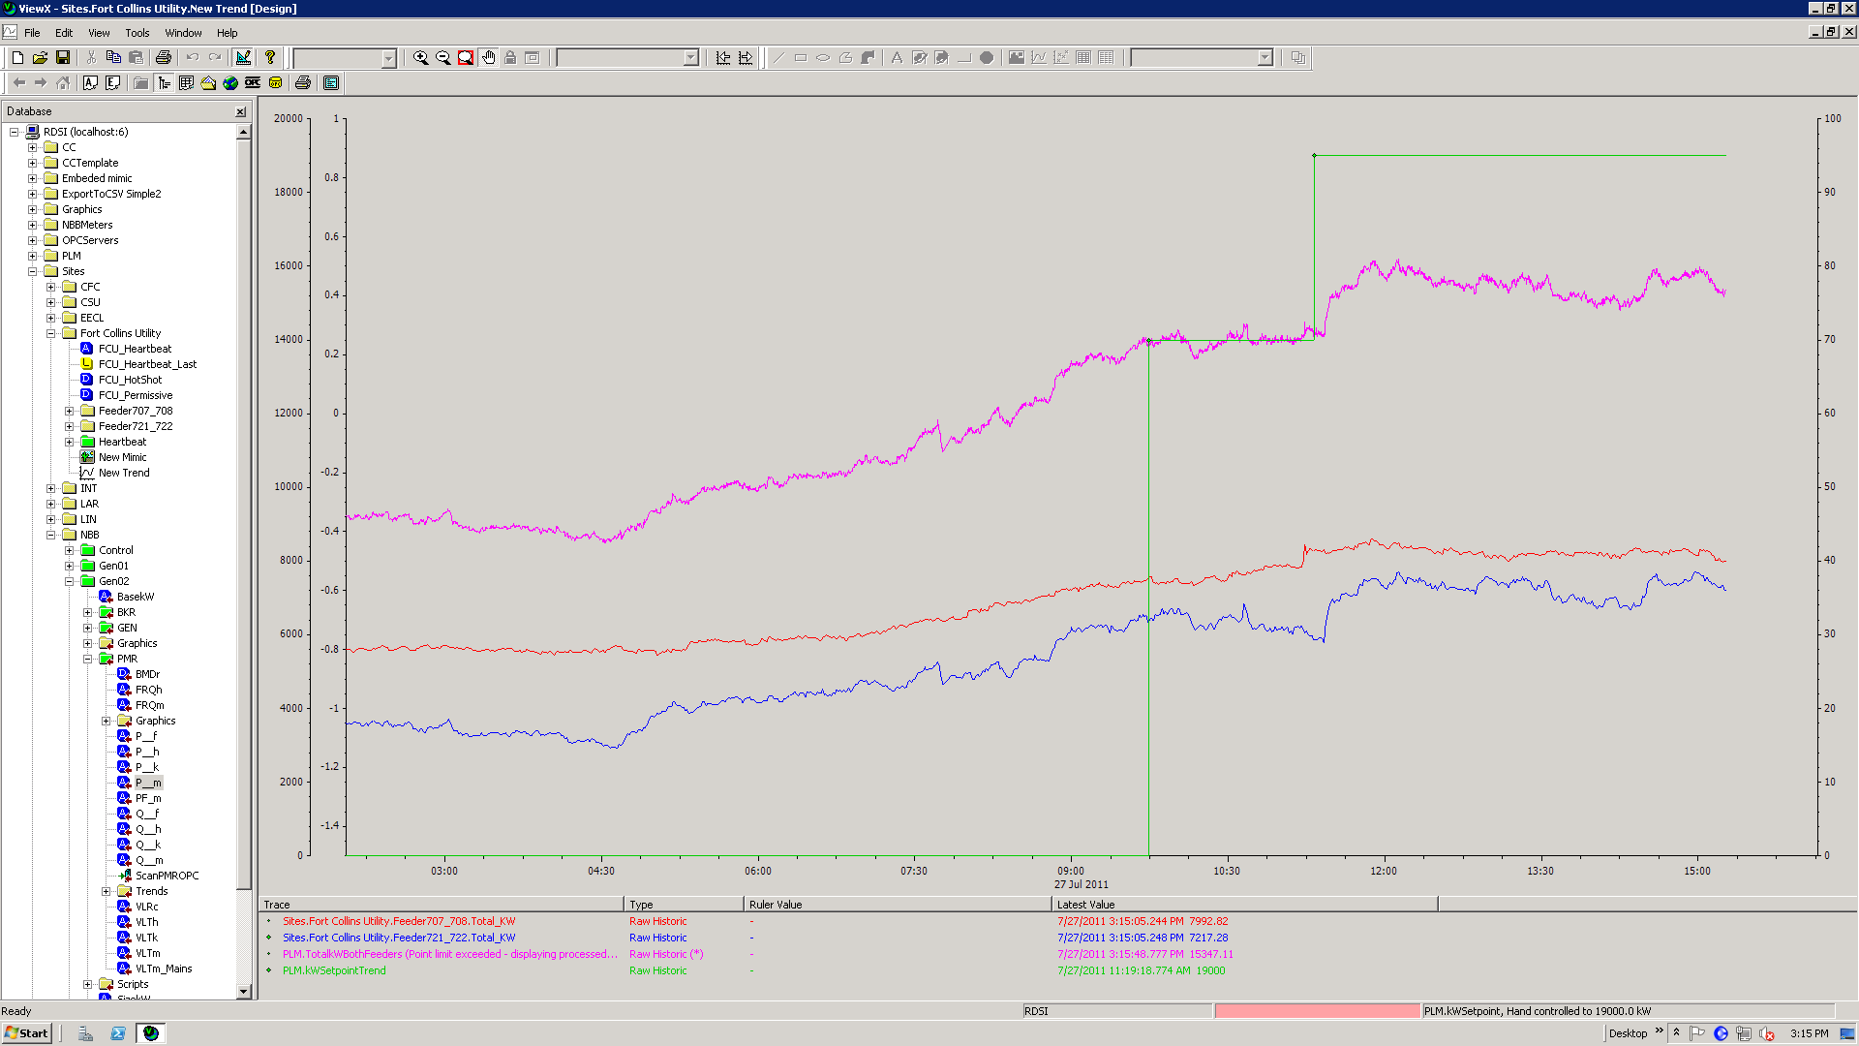
RDSI Impact on Feeder Load– July 27-28, 2011

Slide 25
Why is DG important?
Increased feasibility of local renewable generation
Increased transmission efficiency
Increased system generation capacity
Increased grid and capacity control
Decreased costs for consumers
Decreased transmission and distribution bottlenecks
Decreased emissions

Slide 26
Hindrances impeding distributed generation: regulatory and technical
Interconnection regulations
Net-metering regulations
Volt-Var management
Watt-Volt management
Renewable Curtailment
Watt-frequency management
Voltage Sag ride-through
Dynamic grid stabilization
Stranded existing centralized generation IPP & Utility assets
Impacts of variable renewable resources in distribution feeder voltage and harmonic levels
Redesign of distribution systems

Slide 27
Policies supporting distributed generation
Well-designed interconnection standards
Net-metering standards
Public benefit funds/clean energy funds
Feed-in tariffs
FERC Order 2006 (standardized procedures for interconnection of small QF generators)
FERC Order 755 (October 20, 2011)
Recent FERC order in Iberdrola Renewables, Inc., et al. v. Bonneville Power Admin., 137 FERC 61,185 (Dec. 7, 2011)

Slide 28
FERC Order 755
Final rules for Energy Storage used for Regulation Service
Two-part compensation:
Capacity payment (incl. opportunity cost for providers to stand by)
Market-based performance payment
ESS’ regulation service will benefit more from wholesale market
15 min. and 1 hour frequency regulation in the wholesale market

Slide 29
Recent FERC Order-Iberdrola v. BPA (2011)
Petitioners alleged BPA was discriminating against wind generators in implementing the Environmental Redispatch Policy, which provides for curtailment in violation of BPA’s OATT and Petitioners’ LGIAs
FERC, under the authority granted by FPA 211A, ordered BPA to file tariff revisions that are not unduly discriminatory or preferential
Must provide transmission service on terms and conditions that are comparable to those under which BPA provides transmission service to itself

Slide 30
Implication of the Recent FERC Orders-
FERC Order 755—Opens the door to wind/solar independent generators to add Energy Storage.
Iberdrola—Provides a framework and a background for distributed generation projects across the U.S. to request equal, nondiscriminatory treatment from the transmission interconnection agreements

Slide 31
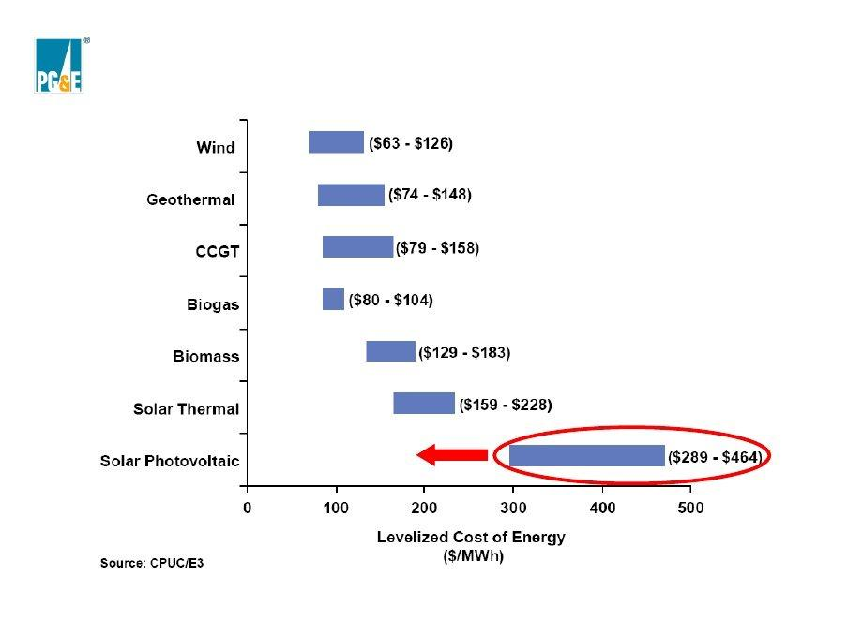
Levelized Cost of Energy

Slide 32
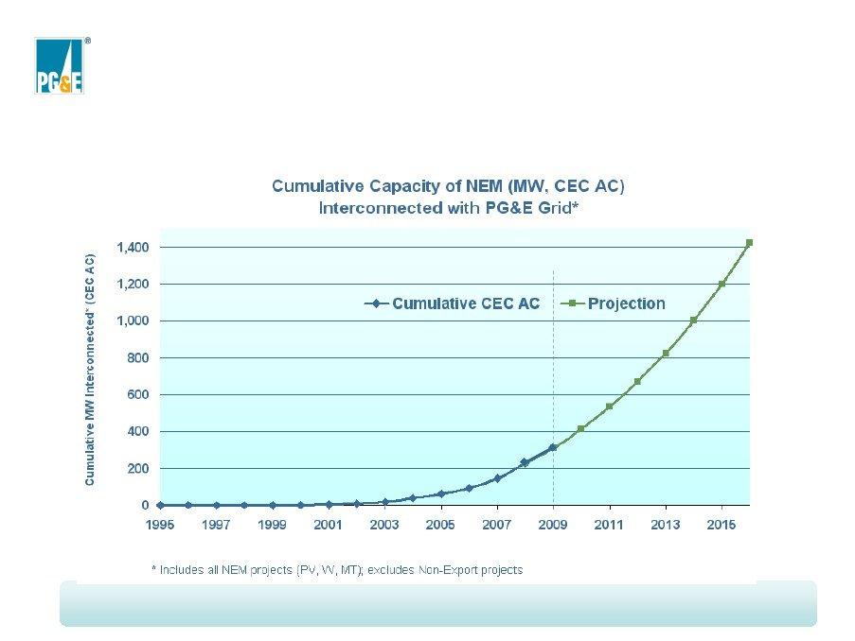
Cumulative Capacity of NEM (MW, CEC, AC) Interconnected with PG&E Grid

Slide 33
www.hoganlovells.com
Hogan Lovells has offices in:
Abu Dhabi
Alicante
Amsterdam
Baltimore
Beijing
Berlin
Brussels
Budapest*
Caracas
Colorado Springs
Denver
Dubai
Dusseldorf
Frankfurt
Hamburg
Hanoi
Ho Chi Minh City
Hong Kong
Houston
Jeddah*
London
Los Angeles
Madrid
Miami
Milan
Moscow
Munich
New York
Northern Virginia
Paris
Philadelphia
Prague
Riyadh*
Rome
San Francisco
Shanghai
Silicon Valley
Singapore
Tokyo
Ulaanbaatar
Warsaw
Washington DC
Zagreb*
"Hogan Lovells" or the "firm" is an international legal practice that includes Hogan Lovells International LLP and Hogan Lovells US LLP.
The word "partner" is used to refer to a member of Hogan Lovells International LLP or a partner of Hogan Lovells US LLP, or an employee or consultant with equivalent standing and qualifications, and to a partner, member, employee or consultant in any of their affiliated businesses who has equivalent standing. Where case studies are included, results achieved do not guarantee similar outcomes for other clients. Attorney Advertising.
© Hogan Lovells 2011. All rights reserved.
*Associated offices
Notes:
33

