Slide 1

Drug Advertising & Promotion:
A Practical Guide to Compliance
Philip Katz October 20, 2011
Partner
Hogan Lovells US LLP
Notes:
1

Slide 2
Agenda
Back to Basics
FDA Enforcement
Preapproval Promotion
Disease Awareness
Internet / Social Media / Digital Media
Television Ads
Reminder Ads
Economic Information
2

Slide 3
Back to Basics
Notes:
3

Slide 4
Food, Drug, and Cosmetic Act
Prohibits promotion of unapproved uses
  Cannot introduce into commerce a “new drug” that does not have an approved application
  A “new drug” can include an approved product that is intended:
    To treat a different disease/condition than that for which it has been approved
    For use in a patient population other than what has been approved
    For use at a different dose than has been approved
4
Notes:
4

Slide 5
Food, Drug, and Cosmetic Act
Prohibits “misbranding” of drug
  Labeling must not be false or misleading
  Labeling must include adequate directions for use
  Advertising must contain brief statement of intended uses and relevant warnings, precautions, side effects, and contraindications
5
Notes:
5

Slide 6
FDA Enforcement
Notes:
6

Slide 7
FDA Enforcement
DDMAC is now the Office of Prescription Drug Promotion (OPDP)
  Tom Abrams, Director
  Mark Askine, Associate Director
  Marci Kiester, Associate Director of Operations
  Catherine Gray, Acting Director of Division of Professional Promotion
  Robert Dean, Acting Director of Division of DTC Promotion
7

Slide 8
FDA Enforcement
DDMAC (OPDP) / APLB Letters
  2007: 19 / 4 Warning & NOV letters
  2008: 21 / 6 Warning & NOV letters
  2009: 41 / 7 Warning & NOV letters
  2010: 52 / 6 Warning & NOV letters
  2011: 21 / 5 Warning & NOV letters to date
8

Slide 9
FDA Enforcement
“Bad Ad” Program launched in May 2010
  Encourages health care professionals to report false or misleading promotional materials or activities
  300+ reports from health care professionals, consumers, industry reps
  Led to 6 Warning/NOV letters, including websites, pharmacist mailer, oral statement by sales rep, YouTube video
9
Notes:
9

Slide 10
FDA Enforcement
FDA intends to expand the “Bad Ad” program
  May include web-based continuing education
  Will focus on educating medical students via collaborations with medical, pharmacy, and nursing schools
  OPDP representatives will be available at medical conferences
10
Notes:
10

Slide 11
Preapproval Promotion
Notes:
11

Slide 12
Preapproval Promotion
Five enforcement letters since January 2010 suggest increased enforcement priority
Earlier this year, CEL-SCI Corporation received the first warning letter for preapproval promotion in recent years
  Website said product is “safe and well tolerated and is non-toxic to healthy cells” and the “only immunotherapy that is able to directly affect both the tumor cells themselves and activate a robust anti-tumor immune response.”
12

Slide 13
Preapproval Promotion
Other recent enforcement letters
  ChemGenex: MOA brochure distributed at medical conference asserted that the product was a “valuable option” because it had “known activity” in certain patients and that “establishment of compassionate use access has been a priority”
  AOI Pharmaceuticals: Website described product as demonstrating “both safety and clinical efficacy in several tumor types” and having a “safety profile [that] is distinctly different from that of most cytotoxic agents”
13

Slide 14

CEL-SCI Warning Letter
14
Notes:
14
-In Park, the SC upheld the misdemeanor conviction of a CEO of a grocery chain that delegated responsibility for correcting sanitation problems at warehouses to other employees.
-On notice: The company/CEO received notice of violations in 2 warning letters.
-WLs: This is why most WLs/and other enforcement are issued to executives – to establish notice.
14

Slide 15
CEL-SCI Warning Letter
15
Notes:
15
-In Park, the SC upheld the misdemeanor conviction of a CEO of a grocery chain that delegated responsibility for correcting sanitation problems at warehouses to other employees.
-On notice: The company/CEO received notice of violations in 2 warning letters.
-WLs: This is why most WLs/and other enforcement are issued to executives – to establish notice.
15

Slide 16
Preapproval Promotion
Legal and Regulatory should carefully review materials discussing pipeline products
  Websites
  Press releases
  Pipeline presentations / brochures
Train sales reps and MSLs about how to appropriately communicate information about investigational drugs
  Venue and context are relevant
16

Slide 17
Preapproval Promotion
Avoid conclusory statements about the safety or effectiveness of the investigational drug
  Stick to the facts; don’t characterize
  Be wary of aspirational statements about the drug’s potential role if approved (e.g., “standard of care”)
  Provide relevant information that will help healthcare professionals assess the data (e.g., p-values, hazard ratio)
  Review statements by investigators or corporate officials
  Scrutinize statements about MOA
17

Slide 18
Disease Awareness
Notes:
18

Slide 19
Disease Awareness
Significant increase in industry use of disease awareness materials and communications
When done correctly, not subject to drug ad regulations – because they’re not drug ads
  Tension between raising awareness about disease and product promotion
Limited guidance from FDA
  2004 Draft Guidance
  Handful of OPDP (DDMAC) Letters
  Informal statements by OPDP officials
19
Notes:
19

Slide 20
Disease Awareness – General Tips
Consider both content and proximity to promotional materials or activities
Understand the scope of the drug label (if approved), and be aware of off-label uses
Understand the nuances of the disease state
Recognize that certain types of disease awareness information carry more risk
  Review internal company documents (e.g., vendor presentations, brand plans, SWOT analysis) to assure that disease awareness materials are not presented as being intended to promote a product
20
Notes:
20

Slide 21
Disease Awareness – Content
    Cannot mention or make representations or suggestions concerning a particular drug
Implied references can be problematic
    Discussing MOA that is unique to a specific drug
    Discussing general categories of treatment options and suggesting that one is more effective or safer than another
    Using patient testimonials that discuss benefits of only one treatment option
    Discussing general treatment outcomes in proximity of drug promotion, when such outcomes are not supported by substantial evidence
21
Notes:
21

Slide 22
Disease Awareness – Content
      Implied References (cont.)
  Company has only one approved drug
  Only one approved drug in described disease state
  Citing studies involving a specific drug
  Similar presentation elements (e.g., themes, story lines, tag lines, color, logos, graphics, images of patients, healthcare professionals)
22
Notes:
22

Slide 23
Disease Awareness – Proximity
    Proximity to promotional materials or activities can “brand” disease awareness materials
    Factors to consider include:
      Product promotion and disease awareness communications combined in a single piece
        What type of disease information is discussed (e.g., disease incidence, symptoms, quality of life, treatment outcomes, treatment options, health economic info)?
        Could the disease section be viewed as broadening the indication or off-label promotion?
23
Notes:
23

Slide 24
Disease Awareness – Proximity
    Factors to consider (cont.)
      Product promotion in close physical proximity to disease awareness communications
        Will the disease awareness communication be placed in the same consumer journal as an advertisement for your drug?
        For disease awareness communication on the Internet (e.g., MSNBC.com, WebMD), are you restricting its placement with other information that could “brand” the communication?
24
Notes:
24

Slide 25
Disease Awareness – Proximity
      Issues of application include:
        If using social media, what are the logistics of how the communication can be forwarded?
      For a link from disease awareness website to product promotion website, does the connecting url include the product name? Is there a landing page?
      If consumers ask for more information via a disease awareness website, will promotional materials be provided?
      How are sales reps trained to use disease awareness materials?
25
Notes:
25

Slide 26
Internet / Social Media / Digital Media
Notes:
26

Slide 27
Internet / Social Media / Digital Media
  Unclear when/if FDA will issue the much-anticipated guidance on using social media
DDMAC/OPDP enforcement letters provide some landmarks
    2011 NOV Letter to Pfizer: No “one-click” rule
    2010 NOV Letter to Novartis: Facebook widget
    2009 NOV Letter to GSK: Banner ad
    2009 NOV Letters to 14 companies: Sponsored links
    2009 Warning Letter to J&J: DTC webcast video
    2008 NOV Letter to Novartis: Banner ad
27

Slide 28
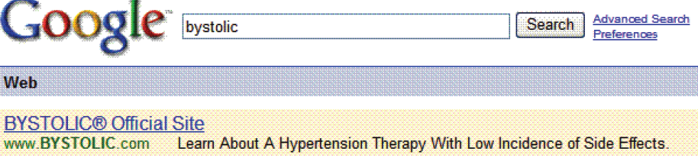
Unique Challenges – Fair Balance
Limited space – Sponsored links and microblogs are limited to 140 characters, and FDA doesn’t believe in the one-click rule
28

Slide 29
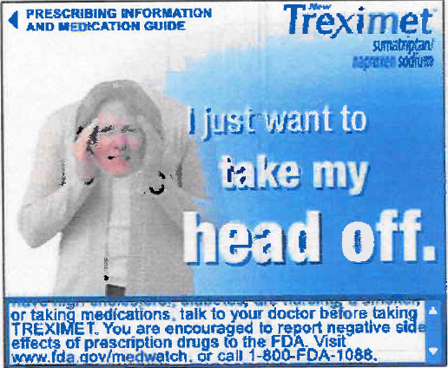
Unique Challenges – Fair Balance
Some options to improve banner ads
Dedicate more space for ISI
Roll over ISI – full ISI pops up if the user passes the mouse over the ad links
Expanding banner ad – entire banner ad expands into a larger box, providing more room for risk information
29

Slide 30
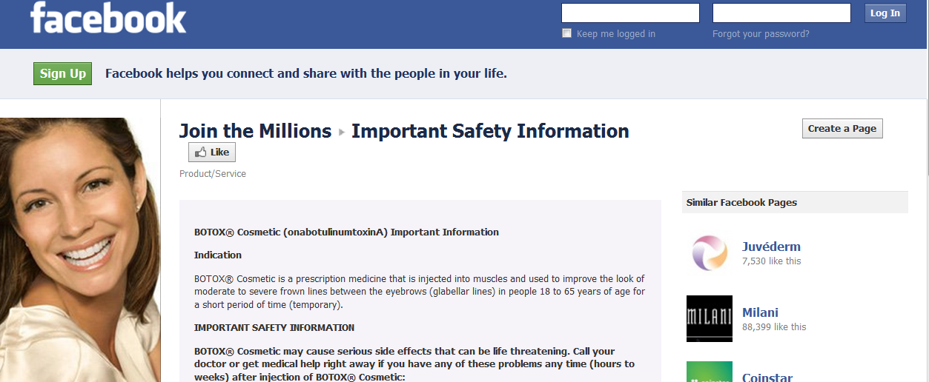
Unique Challenges – Risk Information
Placement of risk information can be an issue
  Right side of Facebook page is for sponsored links
  In August 2011, Facebook says limited ISI will appear continuously at bottom of wall for branded drug Facebook pages
30

Slide 31
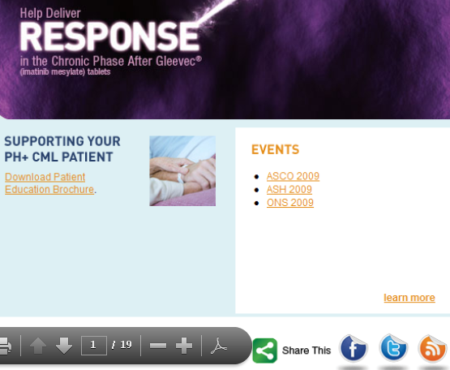
Unique Challenges – Fair Balance
Implications of how drug information can be “shared” with others via social media
Facebook Share is a tool used by members to share content across profiles.
With “2 clicks,” visitor can share webpage through Facebook by generating a link to the page, along with a thumbnail image and brief description that will appear on the user’s profile and, depending on privacy settings, in the home page stream of all of the user’s Facebook friends.
31

Slide 32
Unique Challenges – Fair Balance
NOV Letter to Novartis (Aug. 2010)
  Facebook description presents efficacy information but no risk information, thus minimizing the risk information
32
Notes:
32

Slide 33
Unique Challenges – Product Websites
Hyperlinks allow a product website to include much information, but create challenges for website review
Issues of application include:
  Reviewing content available via each hyperlink, including links to 3rd party websites, which can misbrand a drug
  Having risk information incorporated within embedded videos
  Understanding how the “share” feature or other social media features work
  Understanding how consumers or health care professionals can navigate through the website
33

Slide 34
Unique Challenges – Adverse Event Reporting
1997 FDA guidance says an adverse events must be reported when the company has these data elements:
  Identifiable patient
  Suspect drug product
  Identifiable reporter
  Adverse event or fatal outcome
No obligation to monitor potential adverse events that arise on the Internet or user-generated forums, unless the site is controlled or influenced by the company
  What if user sends an e-mail with adverse event information or posts comments to Sidewiki?
34

Slide 35
Unique Challenges – Adverse Event Reporting
Issues of application include:
  Is there an option to disable “Comments” on user-generated sites (e.g., Facebook, blogs)?
    Recent Facebook policy change now requires comments to be enabled on disease awareness pages
  If comments are enabled, does the company have policies and procedures to continuously monitor sites for potential adverse events?
35

Slide 36
Unique Challenges – Adverse Event Reporting
Issues of application (cont.)
  Monitoring of sites for potential adverse events raises many issues, including:
    Significant resources often required
    Privacy issues may preclude company from attempting to obtain follow-up information
    Company must decide whether to review all comments before posting them
    Does the company have the ability to remove comments?
    Who monitors the sites, the company or a vendor?
36

Slide 37
Television Ads
Notes:
37

Slide 38
Direct-to-Consumer Broadcast Ads
Balancing safety and efficacy information is challenging, given the limited amount of time available
Issues of application include:
  Proportion of time spent on efficacy and risk information
    It’s helpful if storyboard displays the amount of time each fame will appear on screen
  Images can create/imply a claim
      2010 untitled letter said images of Alzheimer patient with a distant, blank stare who later actively interacts with family members overstated the product’s efficacy

Slide 39
Direct-to-Consumer Broadcast Ads
  Issues of application (cont.)
    Use of voiceovers and supers to present efficacy and risk information
  Supers generally are not as prominent as voiceovers
Potential distracting elements when risk information is presented
Importance of reviewing concepts, draft and final storyboards, final layout, and video
Consider submitting to FDA for advisory comments, per PhRMA guidelines

Slide 40
Reminder Ads
Notes:
40

Slide 41
Reminder Ads
    Reminder ads may mention the drug name, but may not contain any claims, express or implied, about the drug’s use
    A reminder ad is a drug ad, but it is not required include the “brief summary” of risk information
    Issues of application include:
      Reminder ads cannot be used for a drug with a boxed warning
      Images can make an implied efficacy claim
      Proximity to other materials that contain statements of the drug’s use can be problematic
41
Notes:
41

Slide 42
Economic Information
Notes:
42

Slide 43
Economic Information
Promotional materials may contain economic information, which often consists of assertions about the economic consequences of using a drug
    At times, the information is comparative of the costs of using different products
  FDA often considers such economic comparisons to be based on an implied representation that the products are comparable in safety and effectiveness, which requires “substantial evidence,” typically in the form of data from head-to-head clinical trials
43

Slide 44
Health Care Economic Information (HCEI)
FDCA specifically provides for sharing HCEI with formulary committees and similar entities
  Such information is required to meet a lesser standard of substantiation than is required of efficacy or safety claims
    “Competent and reliable scientific evidence,” rather than “substantial evidence”
Key issues:
  HCEI must directly relate to an approved indication
  FDA often sees implied clinical claims in economic claims
44
Notes:
44

Slide 45
Health Care Economic Information (HCEI)
HCEI is defined as “any analysis that identifies, measures, or compares the economic consequences, including the costs of the represented health outcomes, of the use of a drug to the use of another drug, to another health care intervention, or to no intervention”
  Typically includes economic inputs (e.g., nursing time, days in the hospital, supplies) and measurements (e.g., cost, cost effectiveness, cost-benefit analyses) relevant to drug’s use
  Cannot include stand-alone claims about safety or efficacy; must tie clinical outcomes to economic measures or consequences
45
Notes:
45

Slide 46
Health Care Economic Information (HCEI)
Relating the economic claim to an approved use isn’t necessarily straightforward
  OK: Economic consequences of fractures for a drug approved to prevent bone fractures due to osteoporosis
  Not OK: Economic claims based on prolonged patient survival for drug approved to treat symptoms of heart failure
  Not OK: Economic claims based on preventing progress of rheumatoid arthritis where the drug is approved only to treat disease symptoms
  Not OK: Cost savings associated with preventing eye and kidney disease for insulin drug approved to control blood sugar
46
Notes:
46

Slide 47
Philip Katz
philip.katz@hoganlovells.com
+1.202.637.5632
www.hoganlovells.com
Hogan Lovells has offices in:
Abu Dhabi
Alicante
Amsterdam
Baltimore
Beijing
Berlin
Brussels
Budapest*
Caracas
Colorado Springs
Denver
Dubai
Dusseldorf
Frankfurt
Hamburg
Hanoi
Ho Chi Minh City
Hong Kong
Houston
Jeddah*
London
Los Angeles
Madrid
Miami
Milan
Moscow
Munich
New York
Northern Virginia
Paris
Philadelphia
Prague
Riyadh*
Rome
San Francisco
Shanghai
Silicon Valley
Singapore
Tokyo
Ulaanbaatar*
Warsaw
Washington DC
Zagreb*
"Hogan Lovells" or the "firm" refers to the international legal practice comprising Hogan Lovells International LLP, Hogan Lovells US LLP, Hogan Lovells Worldwide Group (a Swiss Verein), and their affiliated businesses, each of which is a separate legal entity. Hogan Lovells International LLP is a limited liability partnership registered in England and Wales with registered number OC323639. Registered office and principal place of business: Atlantic House, Holborn Viaduct, London EC1A 2FG. Hogan Lovells US LLP is a limited liability partnership registered in the District of Columbia.
The word "partner" is used to refer to a member of Hogan Lovells International LLP or a partner of Hogan Lovells US LLP, or an employee or consultant with equivalent standing and qualifications, and to a partner, member, employee or consultant in any of their affiliated businesses who has equivalent standing. Rankings and quotes from legal directories and other sources may refer to the former firms of Hogan & Hartson LLP and Lovells LLP. Where case studies are included, results achieved do not guarantee similar outcomes for other clients. New York State Notice: Attorney Advertising.
© Hogan Lovells 2011. All rights reserved.
* Associated offices

