Slide 1
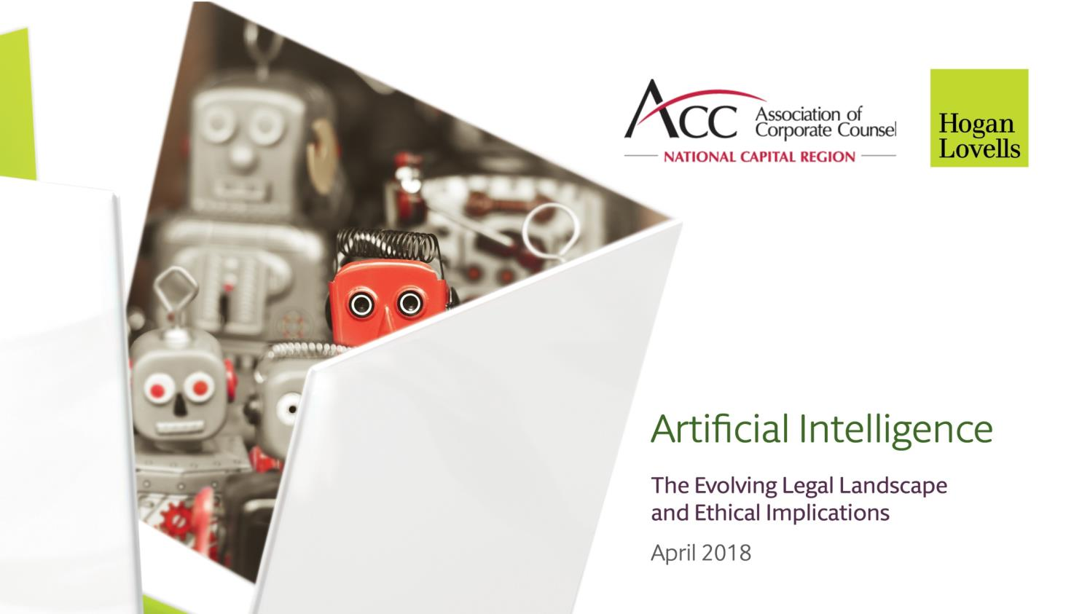

Slide 2
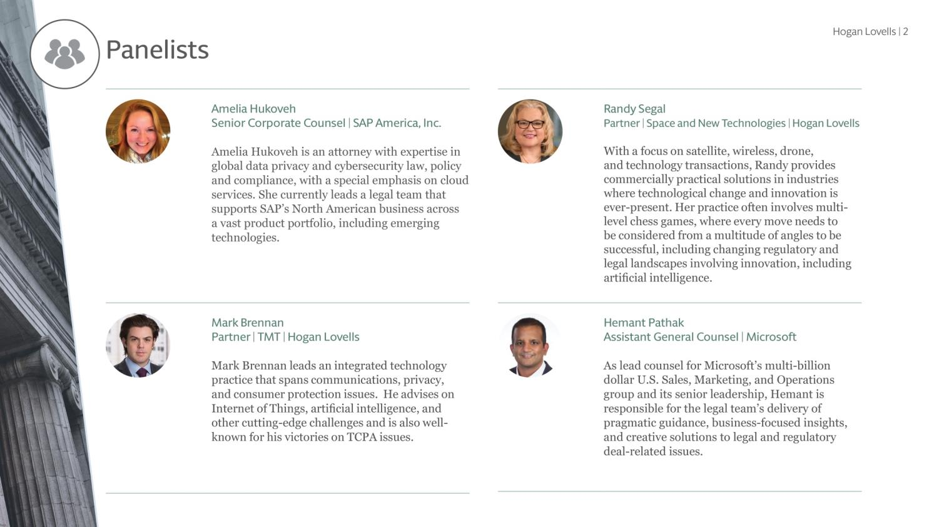

Slide 3
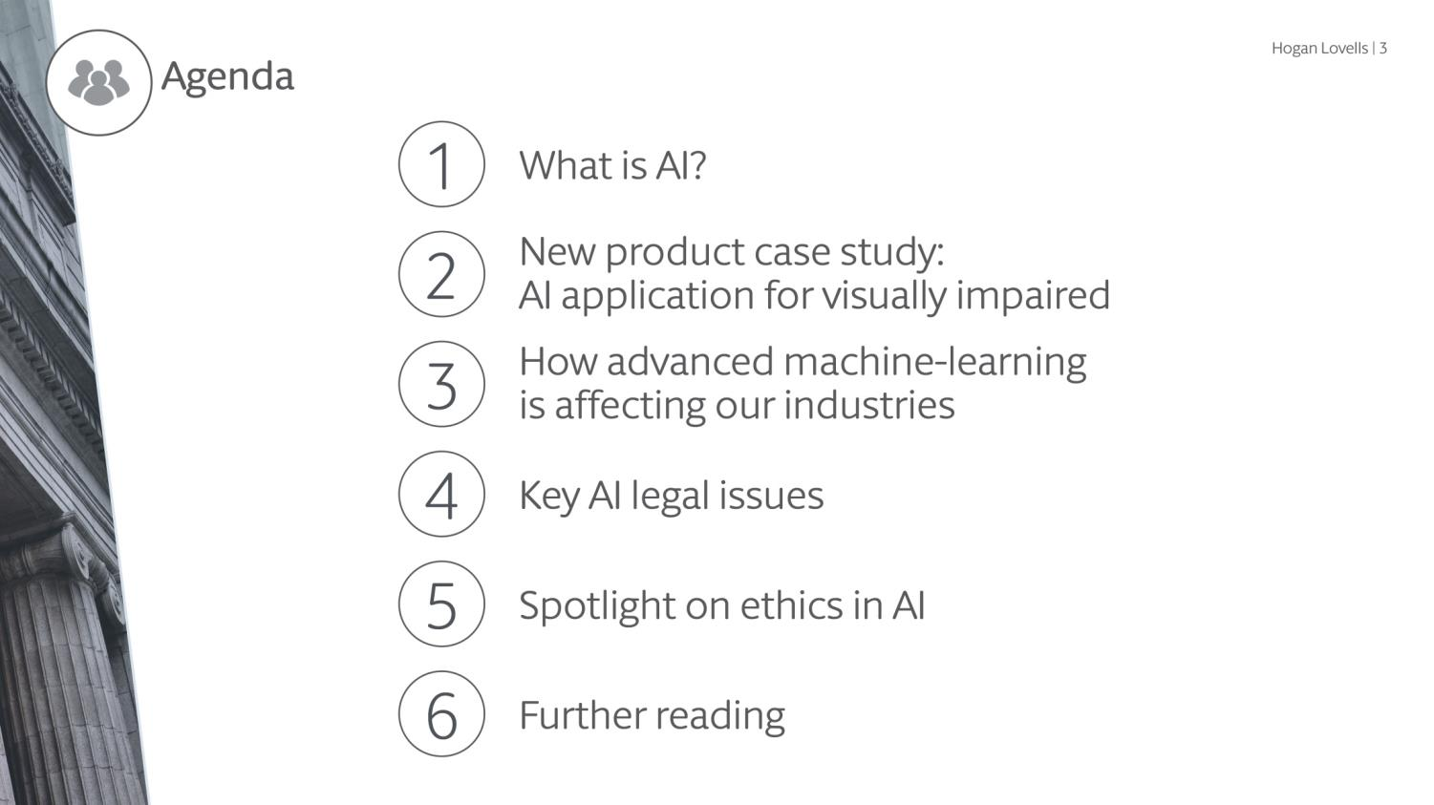
Notes:
TC

Slide 4
Notes:
TC

Slide 5
Machine Learning
Artificial Intelligence
Robotic Process Automation
Business Intelligence
Deep Learning
Bots
Predictive Analytics

Slide 6
Notes:
TC

Slide 7
Using on-device AI + Cloud
Notes:
TC

Slide 8
Using on-device AI + Cloud
Notes:
TC

Slide 11
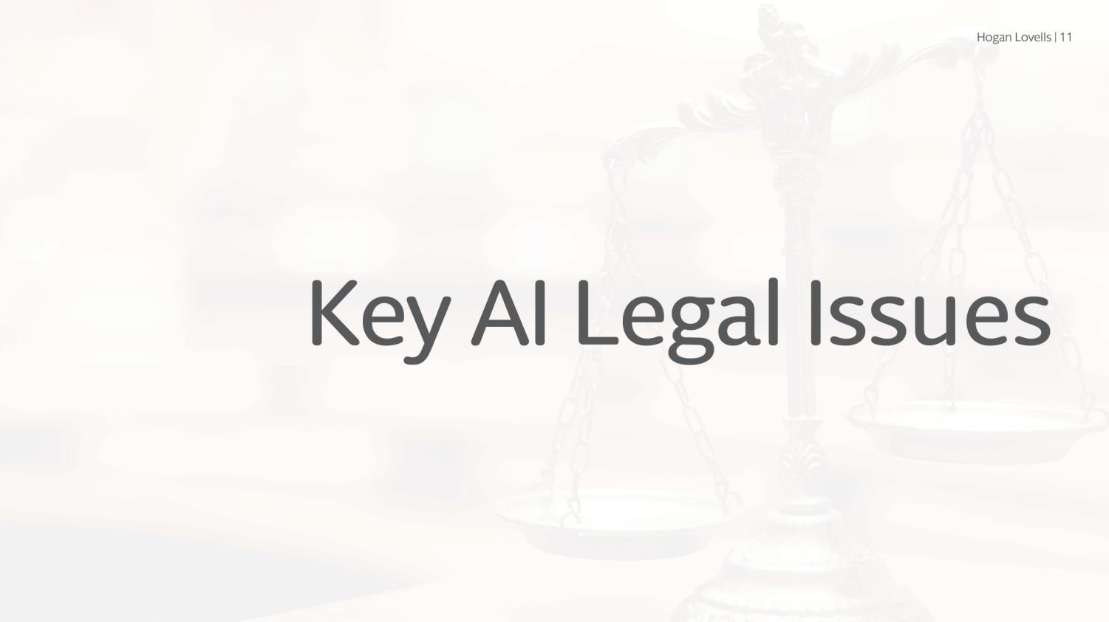

Slide 16
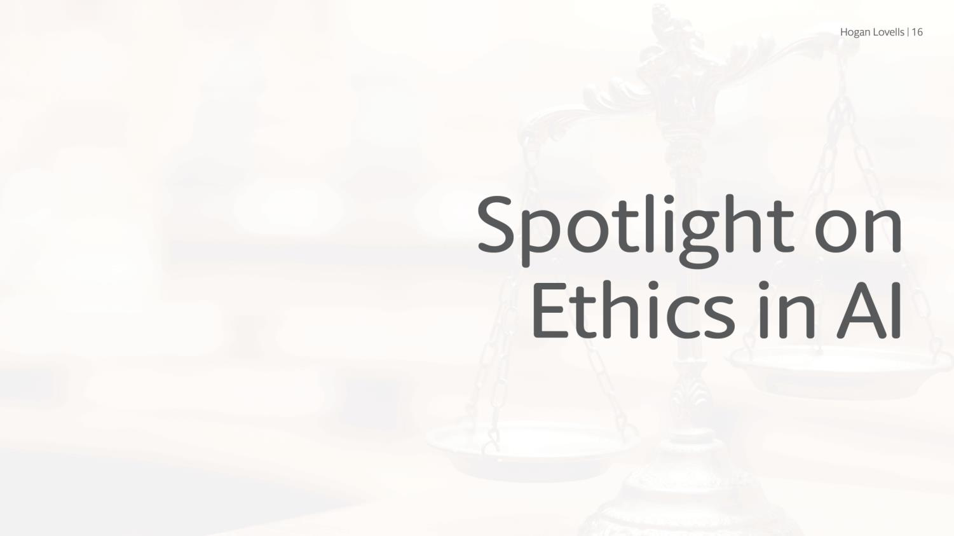

Slide 17
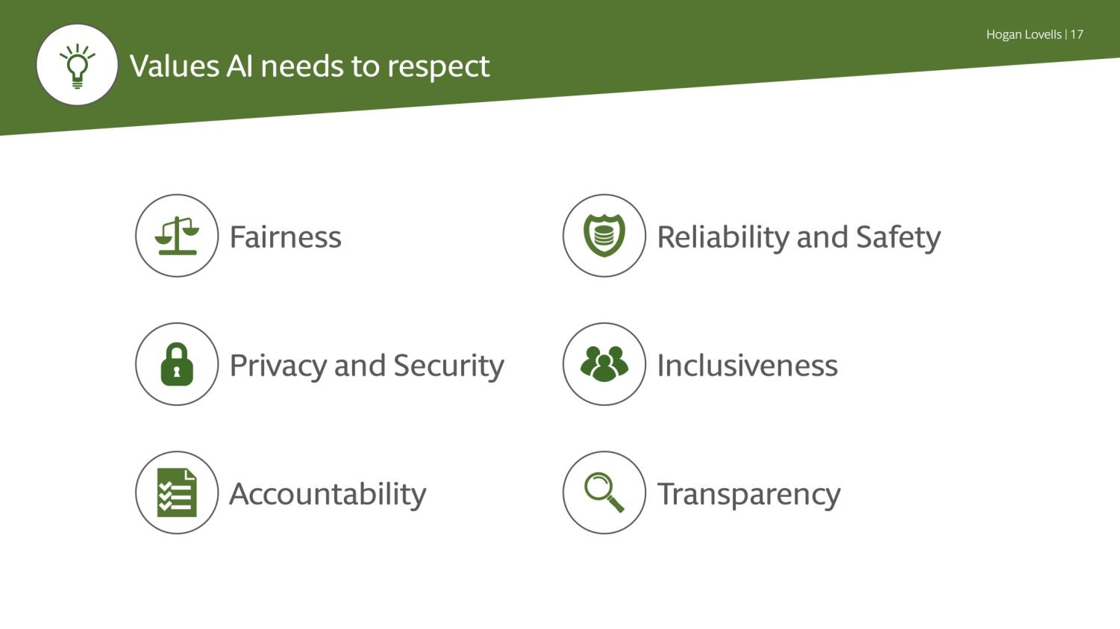
Notes:
TC

Slide 18
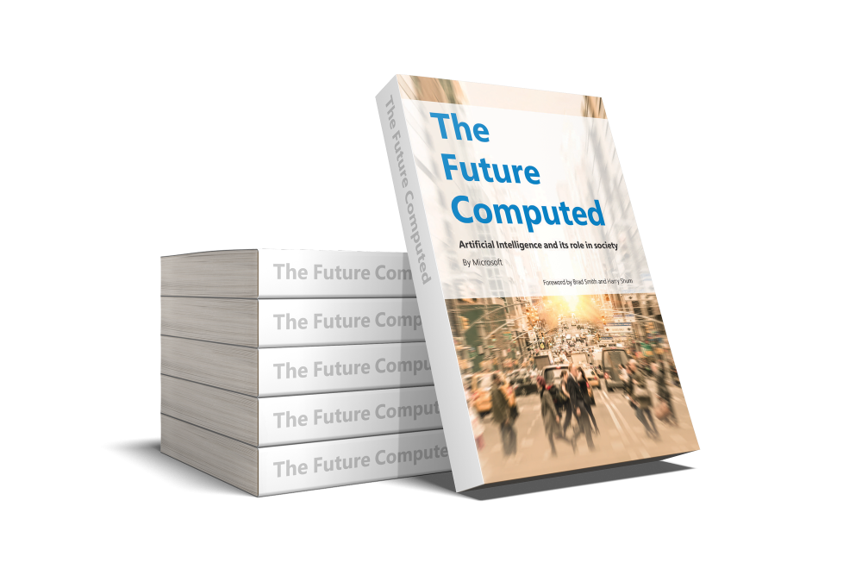
Link to book download: Click here
Notes:
TC

Slide 19
www.hoganlovells.com
"Hogan Lovells" or the "firm" is an international legal practice that includes Hogan Lovells International LLP, Hogan Lovells US LLP and their affiliated businesses. The word “partner” is used to describe a partner or member of Hogan Lovells International LLP, Hogan Lovells US LLP or any of their affiliated entities or any employee or consultant with equivalent standing.. Certain individuals, who are designated as partners, but who are not members of Hogan Lovells International LLP, do not hold qualifications equivalent to members. For more information about Hogan Lovells, the partners and their qualifications, see www.hoganlovells.com. Where case studies are included, results achieved do not guarantee similar outcomes for other clients. Attorney advertising. Images of people may feature current or former lawyers and employees at Hogan Lovells or models not connected with the firm. © Hogan Lovells 2018. All rights reserved

