Slide 1

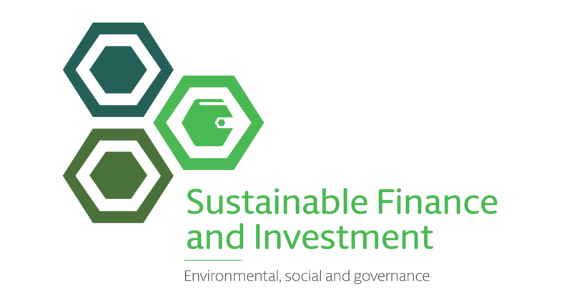
Sustainable Finance
& Investment
2024

Slide 2
Our Global Sustainable Finance & Investment Practice
Sustainable Finance & Investment
Our global Sustainable Finance & Investment group brings together a multidisciplinary global team that provides clients with best-in-market support. We help our clients stay ahead in this rapidly evolving sector, from a transactional and regulatory perspective, through delivering tools, products and solutions to assist them in both overcoming challenges and exploiting the vast range of opportunities in this area.
As you would expect in a relatively new and rapidly developing area, innovation is a core part of the sustainability strategy and the team meets regularly to discuss new trends and design solutions for our clients.
Against this backdrop, we highlight the importance of UN Sustainable Development Goal #17. In order to mobilise capital and create an efficient, scalable, sustainable financial ecosystem, partnerships and collaboration are crucial. Our lawyers are tasked with servicing our clients but also contributing to the development of the sector. We have collaborated on industry initiatives globally with the Loan Markets Association, Borsa Italiana, ISDA, GBBC Digital Finance, European Leveraged Finance Association, UN Global Compact and others.
On sustainability strategy, product development, transactions and risk, we create innovative solutions combining market intelligence, guidance, legal expertise, project management and strategic alignment to facilitate our clients’ business. An important part of this is raising awareness, education and training; our lawyers in this space are committed to sharing expertise and best practice insights, thereby allowing our clients to navigate the complex, wide-ranging set of issues when considering sustainable finance and investment.
Key services
Advising on ESG investment and sustainability policies, ESG strategy, reporting and disclosure and ensuring alignment with corporate strategy and business operations
Advising on the rapidly changing regulatory environment for sustainable finance and investment and helping teams to analyse and apply trade body principles, guidance and relevant reports
Working with trade associations and organisations to develop market guidance and advising on ESG market practices and standards, voluntary codes and goals
ESG due diligence and disclosure advice in the context of debt offerings, client and/or investment portfolio strategy analysis and acquisitions and disposals
Working across Hogan Lovells finance practices and sectors on sustainable finance transactions including green, social, blue and sustainability-linked loans and bonds, ESG fund finance, ESG securitisation, ESG derivatives, ESG trade finance, natural capital investment structures and impact finance and investments
Establishing sustainable investment funds, including Article 8 and Article 9 funds, impact funds and hybrid transactions
Connecting clients, organisations, foundations and enterprises across our network and raising awareness of issues and opportunities
Advising on risk, potential disputes and legal issues including greenwashing, misrepresentation and advertising, regulatory enforcement, class actions, director’s duties and competition-related matters

Slide 3
Our Experience
Sustainable Finance & Investment
Our Sustainable Finance and Investment clients are predominantly in highly regulated sectors, including financial services, life sciences, tech and energy - we utilise a multidisciplinary approach, that draws in global regulatory and government public policy expertise to work alongside the core transactional and advisory teams, in order to help our clients manage ESG risks and maximise the opportunities for long-term sustainable profits and positive impact.
International Finance Corporation (IFC) on its partnership with CapitaLand Ascott Trust (CLAS) in connection with CLAS’s issuance of a 16.5 billion yen (US$157.4 million) sustainability-linked bond.
A major international bank in relation to the interpretation and implementation of the SFDR and other related pieces of environmental, social, and governance (ESG) related regulation. This involves answering regulatory queries on a monthly basis and providing a "helpline" to the team.
A major asset manager on its ESG reporting obligations in connection with SFDR, EU Taxonomy and TCFD.
A large German real estate asset manager on its SFDR product disclosure wording for its Article 8 fund.
A private equity fund on its implementation of the SFDR requirements.
Various infrastructure and real estate funds on the application of the SFDR, the EU Taxonomy and assisting with their SFDR implementation.
An Article 6 real estate fund on its conversion to Article 8 under the SFDR and drafting product disclosures, including the RTS disclosure template.
Cassa Depositi e Prestiti S.p.A. (CDP) on the issue of the first Italian Sustainability Bond for a nominal amount of €500m reserved to institutional investors.
A syndicate of banks (Crédit Agricole CIB, HSBC, Société Générale, Barclays, BofA Securities, Wells Fargo, Danske Bank, Standard Chartered Bank AG) in connection with the issuance, by Rexel, of €400 million 5.250% unsecured sustainability-linked senior notes due 2030.
A club of banks on the refinancing (by way of sustainability linked-loan) of the Nuffield Health group's existing term and revolving facilities and repayment of private placement notes
Bayerische Landesbank as arranger, ABN AMRO Bank, DZ Bank, Natixis and UniCredit on the world’s first placement of a Blue Social Bond of Deutsche Kreditbank for the refinancing of the municipal water supply and sanitation business in Germany.
A leading French investment bank on its ESG structured products programme including regulatory requirements and risk management under MiFID II.
Various fund managers on SFDR obligations and drafting pre contractual and entity level disclosures.
The Carbon Trust on the establishment of their Green bond and Climate bond third-party verification business.
Affinity Water in relation to various sustainability-linked loans at different levels in their structure which includes KPIs developed to align to key UK water sector sustainability strategy.

Slide 4
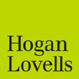
www.hoganlovells.com
"Hogan Lovells" or the "firm" is an international legal practice that includes Hogan Lovells International LLP, Hogan Lovells US LLP and their affiliated businesses.
The word "partner" is used to describe a partner or member of Hogan Lovells International LLP, Hogan Lovells US LLP or any of their affiliated entities or any employee or consultant with equivalent standing. Certain individuals, who are designated as partners, but who are not members of Hogan Lovells International LLP, do not hold qualifications equivalent to members.
For more information about Hogan Lovells, the partners and their qualifications, see www.hoganlovells.com.
Where case studies are included, results achieved do not guarantee similar outcomes for other clients. Attorney advertising. Images of people may feature current or former lawyers and employees at Hogan Lovells or models not connected with the firm.
© Hogan Lovells 2024. All rights reserved.

