Slide 1

Update for life insurance mutuals:
Brexit, mutual deferred shares and other developments
September 2016
Notes:
Note – 3D supergraphic ‘mask’ is now a selectable object in foreground of slide.

Slide 2



Today's speakers
Charles Rix
Head of Insurance Industry Sector
Partner, London
T +44 20 7296 5425
charles.rix@hoganlovells.com
John Gilbert
Consultant
T +44 20 7296 2352
john.gilbert@hoganlovells.com
Jonathan Russell
Senior Associate
T +44 20 7296 5812
jonathan.russell@hoganlovells.com
Please submit your questions online during today's webinar, or send them by e-mail to any of our contacts.

Slide 3
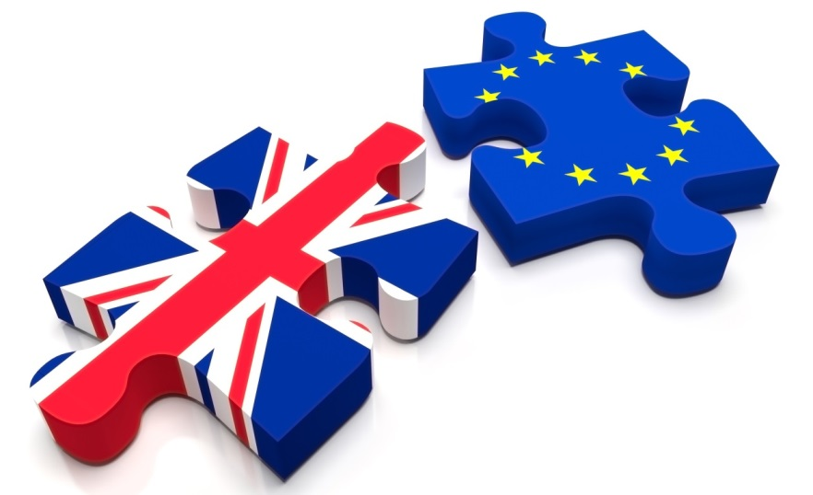
Topics for today's webinar
The Brexit process and its impact on life insurance mutuals
Mutual deferred shares
Developments in insurance industry M&A

Slide 4
The Brexit process
Article 50
  2 years from notice
  Start gun is in UK's hands – or is it?
Regulatory position - on-going compliance with existing regulations until Brexit
High level issues
  EEA market access (passporting)
  Access for EEA firms to the UK insurance market
  Solvency II equivalence

Slide 5
What might the UK agree?
Regime | Passporting | Influence over EU legislation | Comment
EEA (Norway Model) | Yes | Consultation rights – no veto | Retains access to EEA Market Requires free movement of persons Potentially quickest to implement
Co-operation Agreements (Swiss Model) | Depends on what is negotiated | No | Passporting conditional on free movement of persons?
Comprehensive Free Trade Agreement | Depends on what is negotiated | No | Time consuming to negotiate Passporting conditional on free movement of persons?
Reliance on WTO rules | No | No
Notes:
Single Market – EEA member state (the Norway model)
Potentially least-significant impact on UK and EU financial institutions
Will involve retention of existing EU measures, and adoption of new EU measures
UK retains access to the EEA single market – passporting continues to apply
Potentially quick to implement, as the UK already applies EEA measures
But
UK required to allow free movement of people
UK loses ability to influence development of EU regulation
Likely to be politically difficult – given the Leave campaign advocated no longer being part of the EEA
Co-Operation Agreements (Swiss Model)
Bilateral agreements between UK and EU on specific topics
Time consuming to implement
Fragmented
Likely to require free movement of persons in any event (Swiss model under threat after referendum limiting free movement)
Unlikely to be contemplated by the EU
Comprehensive Free Trade Agreement
Bilateral agreement between UK and EU, covering wide range of trade and services (including financial services)
Unlikely to result in level of cross-border access available under EEA
Unlikely to be put in place quickly

Slide 6
What should you do now?
Assess impact and identify priorities
Develop contingency plans
Engage in lobbying now
  Start now to help shape the policy agenda - opportunity to lead change
  Lack of UK capacity and experience of negotiation - business needs to fill the gap
  Need to influence via multiple routes - Brussels, London and other key capitals

Slide 7
Restructuring options for UK insurers
UK insurer and EEA insurer with passporting rights
EEA insurer with passporting rights with UK branch authorised to conduct insurance business in the UK
Part VII FSMA
Convert to a Societas Europaea?
Some restructuring mechanisms may only be available until Brexit (eg SE and cross-border merger process). For mechanisms that are available post-Brexit, recognition of UK court order may be an issue

Slide 8
Impact on existing business operations
Impact on existing business operations
Impact on value of investments
Recalculation of technical provisions and capital requirement
Will termination rights or collateral provisions be triggered?
Impact on conditionality (eg MAC clauses)
Anticipating Brexit in new contracts – retaining flexibility

Slide 9
Impact of lower interest rates
Guarantees available to policyholders under policy terms have become more expensive
Options:
  Can the original policy terms be enforced?
  Do policy terms permit any amendments?
  Can any business be hived off into a separate sub-fund?
  Can guarantees be compromised under a scheme of arrangement?

Slide 10
Mutual Deferred Shares – the story so far
Private Member's Bill in House of Lords
  Enabling legislation
  Adopted by Government with all party support
  Royal Assent, March 2015
Discussions with HM Treasury, PRA, FCA, HMRC etc, September 2015
Consultation Paper and Draft Regulations published August 2016

Slide 11
Mutual Deferred Shares
Features prescribed by the Act:
  Available to Friendly Societies and "Mutual Insurers", ie companies limited by guarantee
  Permanent capital
  Not shares for purposes of the Companies Acts
  Preserve mutuality:
    One member, one vote
    No voting rights on amalgamations and transfers

Slide 12
Mutual Deferred Shares – HM Treasury consultation
Binary choice between unrestricted and restricted Tier 1 'Own Funds'
  Must be one or the other
  Once choice has been made, it is permanent
Segregation of members' and policyholders' funds
  Chrysalis exercise under COBS 20.2.61?
  Or does wording of regulation imply a less formal segregation?
Dividends payable from 'distributable items'
  Defined by reference to s830 Companies Act
  Position of Friendly Societies?
Consultation closes 30 September

Slide 13
Mutual Deferred Shares – FCA consultation
Quarterly Consultation CP16/21
  FCA concerns about sales to unsophisticated retail investors
  Follows COBS 22 approach for building society CCDS
    Sales to professional and eligible counterparty clients, certified and self-certified sophisticated investors, certified high net worth investors
    Sales to other retail investors subject to extensive health warnings
  Consultation closes 2 November

Slide 14
Mutual Deferred Shares – the uncertainties
Uncertainty over tax
Uncertainty over friendly society issuers
Uncertainty over shareholders' voting rights
Uncertainty over costs
Uncertainty over timing

Slide 15
Other regulatory developments
Corporate governance, member participation and the "legitimacy" of mutuals
Insurance Distribution Directive
TR16/2 – Thematic Review on fair treatment of long-standing insurance customers

Slide 16
Recent M&A market trends
High level of M&A activity in the insurance sector (both globally and within the UK) over the past few years
Factors driving transactions across the sector?
Specific drivers for mutual insurance transactions
  Mergers – securing transferring firm's position and expanding/diversifying transferee.
    What protections can be built in for members?
  Building growth in key strategic areas
  Improving capital position and returns to members

Slide 17
Impact of Solvency II on M&A
Higher capital requirements
Diversification benefit
Public disclosure of financial information
Consequences of breach of capital requirements
Investments

Slide 18
Public disclosure of financial information
Scope of public disclosure
  amounts of Solvency Capital Requirement ("SCR") and the Minimum Capital Requirement ("MCR")
  non-compliance with the MCR and significant non-compliance with the SCR during the reporting period
  business and performance of the insurer
  adequacy of the governance system
  risk exposure, concentration, mitigation and sensitivity of each category of risk for the business
  structure, quality and amount of own funds
Disclosure at individual company and group level
Separate disclosure of SCR and any capital add-on
  UK: two year opt out

Slide 19
Breach of SCR
Firm must immediately notify its regulator when it observes that that the SCR has been breach or there is a risk of non-compliance in the next three months
Within two months, submit a realistic recovery plan to its regulator for approval, setting out how it intends to restore the position within six months
Time periods may be extended by regulator by three months, or in the event of an exceptional fall in financial markets seven years

Slide 20
Investments
Changes made by Solvency II
  removal of requirement to invest in only specified categories of assets (admissible assets) to cover technical provisions
  removal of asset and counterparty exposure limits
  application of the prudent person principle to all assets of firms, with capital charges for different asset classes
Change in investment strategies a trend since the financial crisis
  infrastructure investments, loan portfolios, commercial real estate debt
Matching adjustment approvals?

Slide 21
Transfers of engagements and Part VIIs
The most common method for merging or transferring specific portfolios of business
Recent points of regulatory focus
  Scope of the IE's analysis of the firms' actuarial methodology and assumptions
  The IE's independence: firmwide basis rather than an individual basis
  Amendment provisions
  Governance and conflicts of interest
  Re Excess Insurance – a trend towards disclosure of material legal advice to the Court and IE

Slide 22
Any questions?
Charles Rix
Head of Insurance Industry Sector
Partner, London
T +44 20 7296 5425
charles.rix@hoganlovells.com
John Gilbert
Consultant
T +44 20 7296 2352
john.gilbert@hoganlovells.com
Jonathan Russell
Senior Associate
T +44 20 7296 5812
jonathan.russell@hoganlovells.com
Please submit your questions online during today's webinar, or send them by e-mail to any of our contacts.

Slide 23
Update for life insurance mutuals:
Brexit, mutual deferred shares and other developments
September 2016
Notes:
Note – 3D supergraphic ‘mask’ is now a selectable object in foreground of slide.

