Slide 1



The U.S. Election Results Are In:
A Look at What the Outcome Means for Mexico/U.S. Relations
The U.S. Election Results Are In:
A Look at What the Outcome Means for Mexico/U.S. Relations
November 17, 2016
November 17, 2016

Slide 2
Introduction

Slide 3
Hogan Lovells Presenters
Robert D. Kyle, Partner, Washington, D.C.
Juan Francisco Torres Landa, Managing Partner, Mexico
Chandri Navarro, Partner, Washington, D.C.
Warren H. Maruyama, Partner, Washington, D.C.
Kyle Simpson, Senior Advisor, Washington, D.C.
Mario Jorge Yáñez V., Partner, Monterrey, Mexico

Slide 4
Mexico/U.S. Relations Going Forward

Slide 5
Mexico/U.S. Bilateral Relations Going Forward
Impact of Trump presidency on Mexico/U.S. bilateral relations
Moving beyond the rhetoric
Focus on immigration and trade issues
Potential significant opposition from the private sector
NAFTA remains intact for now
Communicate on the benefits of trade and investment with Mexico
Continued overall stability of the Mexican economy

Slide 6
The Results: Who Won – Who Lost

Slide 7
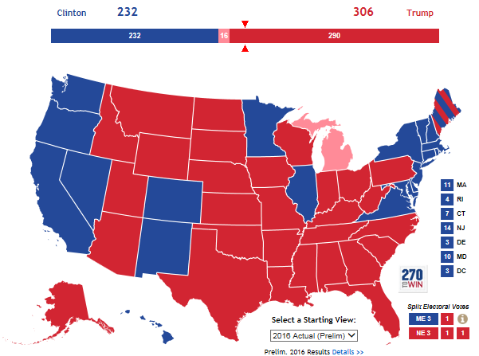
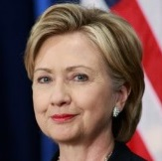
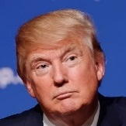
Donald Trump Wins The Presidency With 306
Electoral Votes-Hillary Clinton Wins The Popular Vote
2016 Electoral College Map (As of Nov.16, 2016)
Hillary Clinton (D)
Running Mate: Tim Kaine Popular Vote: 47.7%
States Carried: 20 + DC
Donald Trump (R)
Running Mate: Mike Pence
Popular Vote: 47.5%
States Carried: 30
HI
4
*States not officially called but leaning towards shade indicated on the map
Source: RealClearPolitics, “Electoral College Map,” 2016.

Slide 8
Republican Party Retains A Majority In The Senate
Control of the 114th vs. 115th Senate
■ Democrats ■ Republicans ■ Independents Not yet called
Control of the 114th Senate (2014-2016)
Control of the 115th Senate (2016-2018)
44
54
46
51
44-2-54
46-2-51
Republican Senate Majority
Republican Senate Majority
*Louisiana Senate race not yet called
Source: National Journal research, 2016.

Slide 9
Republicans Retain Control Of House; Limit Democratic Gains In 2016 Elections
Control of the 114th vs. 115th House
■ Democrats ■ Republicans ■ Independents ■ Not yet called Vacant
Control of the 114th House (2014-2016)
Control of the 115th House (2016-2018)
218 Needed for Majority
218 Needed for Majority
186-246
193-238
Republican House Majority
Republican House Majority
*As of 12:00 PM on Nov. 10, four House races have yet to be called
Sources: National Journal research, 2016.

Slide 10
Analysis of Election Results:
What Really Happened?

Slide 11
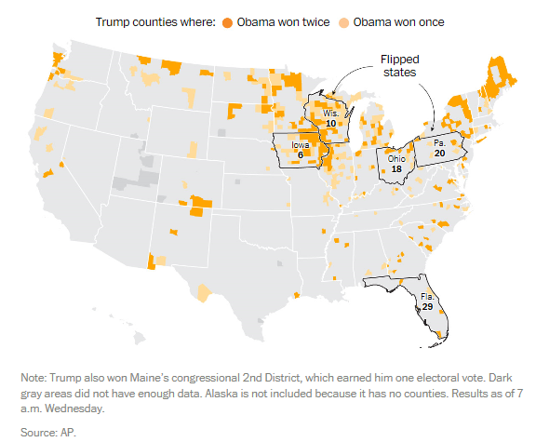
Trump Won Five States That
Obama Carried

Slide 12
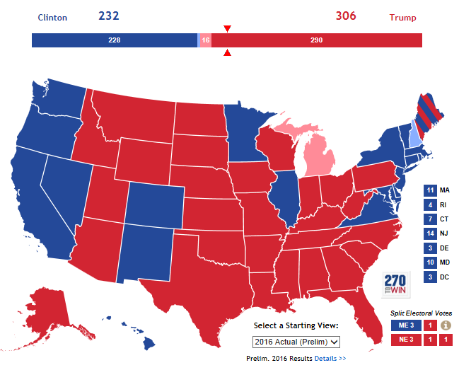
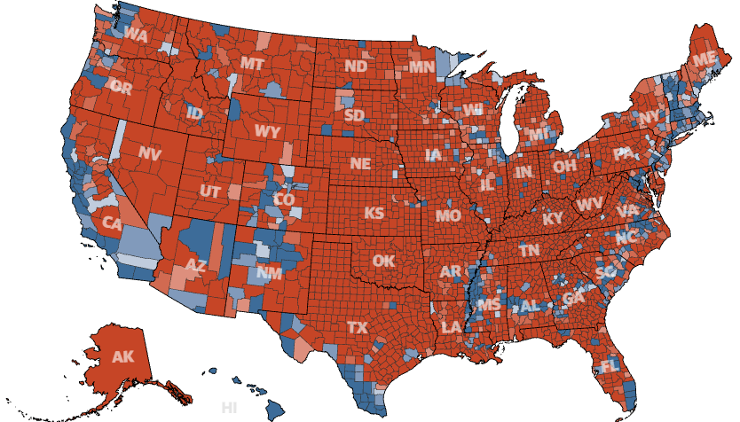
Profound Split Between Urban And Rural Communities In The United States
2016 Presidential by State
2016 Presidential by County
Source: The Guardian

Slide 13
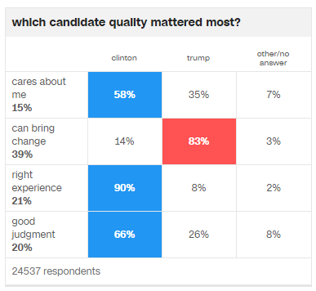
Trump Voters Clearly Valued Change Over Experience . . .
Source: CNN

Slide 14
. . . Even Though They Had Reservations About Trump Personally
Voter Views of Donald Trump:
Had a favorable opinion of him: 38%
Is honest and trustworthy: 33%
Qualified to be President: 38%
Temperament to Serve Effectively as President: 35%

Slide 15
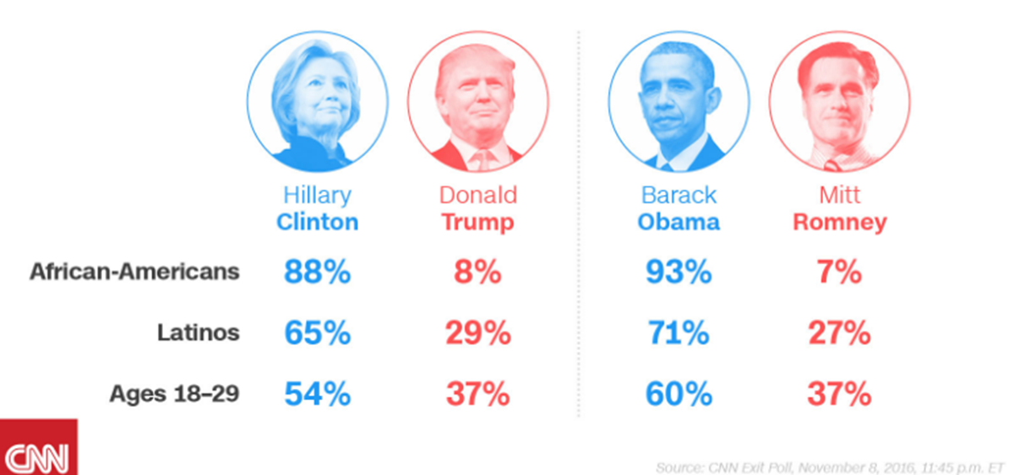
Clinton Underperformed Obama With Key Democratic Groups

Slide 16
How Did Pundits Miss The Trump Voters?
Polls may not have been as inaccurate as reported
Lower educated voters under-weighted in polling
Faith in massive ground game, fundraising advantage and paid media-and “Big Blue Wall” overrated
Polls didn’t accurately gauge intensity and depth of voter anger

Slide 17
Specific Issue Areas

Slide 18

International Trade
Main Point
NAFTA
China - Other Actions
Candidate Trump threatened to raise U.S. tariffs on China by 45%. Various Presidential authorities authorize him to raise tariffs substantially for trade, national security, or balance of payments reasons.
President Trump will have authority to implement many of his campaign commitments without Congressional approval.
Candidate Trump promised to terminate or renegotiate NAFTA within first 100 days in office. President Trump will have authority to give six months’ notice to Mexico/Canada to terminate agreement.
Trans-Pacific Partnership
Currency Manipulation
Candidate Trump said he will withdraw from TPP within first 100 days in office. (U.S. has not approved agreement).
Candidate Trump said he will name China a currency manipulator within first 100 days.

Slide 19
International Trade – What Should You Do?
Four Step Plan
Understand Presidential Authorities
Analyze Corporate Vulnerabilities
Assess Corporate Options
Monitor/ Anticipate/ Respond

Slide 20
Trade (Mexico’s Perspective)
Renegotiation of NAFTA
What happens if the Trump Administration decides to leave NAFTA
Mexico’s Trade Programs
New Visa Issuance and Reform of Legal Potential Setbacks

Slide 21
Automotive
Pressure on automakers and other manufacturers
Potential imposition of 10%-35% tariff on vehicles and parts made in Mexico
Over $6.6 billion invested by Ford and GM. $24 billion in investment from the industry since 2010.
Mexico accounts for 20% of all vehicle production in North America
Capacity could grow by another 50% over the next five years

Slide 22
Immigration
Withdrawal from or Renegotiation of NAFTA
Cancellation of Obama’s Executive Orders, Deferred Action for Childhood Arrivals (DACA), and Deferred Action for Parents of Americans (DAPA)
Focus on Illegal Immigration
New Visa Issuance and Reform of Legal Immigration
Severe Economic Impact of Deportation

Slide 23
Immigration (Mexico’s Perspective)
Renegotiation of NAFTA
If the U.S. leaves NAFTA
If the U.S. implements a tougher immigration policy for Mexico

Slide 24
Energy
CEQ Guidance - Social Cost of Carbon
Paris Agreement
Clean Power Plan
Methane Rules
Waters of the United States
TransCanada Pipeline
U.S. Energy Production

Slide 25

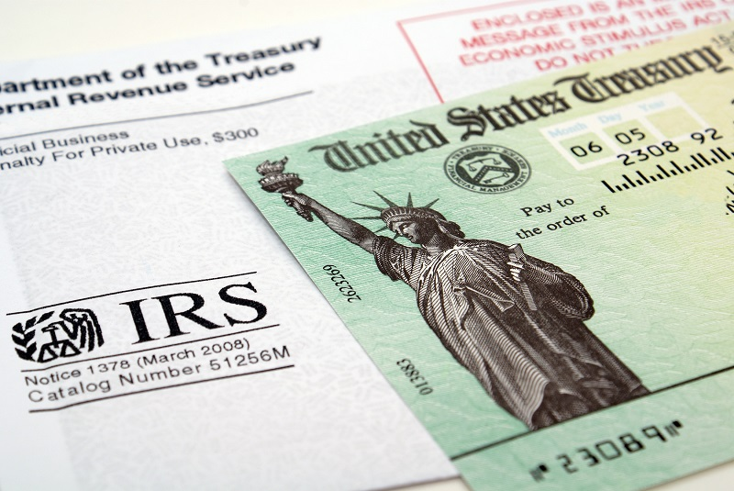

Tax/Infrastructure
Main Point:
Bipartisan Support:
Repatriation of Profits:
Corporate / Individual:
Tax/infrastructure initiative likely to be early White House/Congressional initiative, funded in part by repatriation of foreign earnings by U.S. corporations.
Both parties support some combination of tax cuts and infrastructure spending. Trump emphasizes “jobs” as a priority.
Repatriation could increase U.S. Federal revenues by $150-200 billion. Pays for domestic initiative.
Large issue whether initiative touches only corporate rates or individual rates as well.

Slide 26
Monetary Policy
Federal Reserve Composition
Yellen/Chair:
Other Seats Open:
Yellen term expires February 3, 2018. Trump appoints successor. Early resignation?
Two Board seats currently unfilled. Senate confirmation required.
Federal Reserve Policy
Trump:
Future Policy:
Fed/White House:
Somewhat hawkish. Believes Fed should have raised rates more aggressively.
Fed direction is already to raise rates. Pace is chief issue.
Fed reasonably independent. But close coordination between White House and Fed is possible.

Slide 27

Monetary Policy
Market Reactions to Trump
Deficits Expected:
Markets pricing in higher deficit spending. Tax cuts/infrastructure/jobs bill.
More Aggressive Rate Hikes:
Markets also pricing in a more aggressive Federal Reserve.
Fiscal Stimulus Chief Force:
Fiscal stimulus expectations appear to exceed fears of trade wars, international disruptions.

Slide 28
Q&A

